Slide 1
Software Architecture Connectors
An architectural modeling notation is a language or means of capturing
design decisions.
Notes Adapted from:
Software Architecture: Foundations, Theory, and Practice, Taylor et al.
Modeling and Simulating Software Architectures: The Palladio Approach, Reussner et al.

Slide 2
Component Design and Separation of Concern
Designing involve:
Coming up with “application” functional components &
Integrating these functional components:
Inter-changing control
Inter-changing data
However, when components may NOT be designed
a) by the same person, and/or
b) at the same time period, and/or
c) for the same platform and environment, and/or
d) assuming the same implementation tools,
e) etc.,
then there is a good chance that they can not be integrated
Separation
of concern
Mismatch may be more than just the “call mechanism”; it may involve a set of
“interactions” such as a sequence of exchanges to recover an error.

Slide 3
Components, Interfaces & Mismatches
May need a “connector”
to integrate these two
components
Component
B
Component
A
-Accepts id and password;
-Verifies id and password;
-Counts the number of times id-password
check is being asked for the same user;
-Returns two parameters (verification success
or failure and number of times the same
user asked for “logging in”)
-May run on UNIX, MS Window, or Mac OS X
-No DB specified
-Asks users to input id and password;
-Reads the user id and password;
-Sends the id and password to be verified;
-Expects a yes or no return code
-Works with MS internet explorer and
Mozilla Firefox

Slide 4
What is a Software Connector?
Architectural element that models
Interactions among components
Rules that govern those interactions
Simple interactions
Procedure calls
Shared variable access
Complex & semantically rich interactions
Client-server protocols
Database access protocols
Asynchronous event multicast
Each connector provides
Interaction duct(s)
Transfer of control and/or data

Slide 5
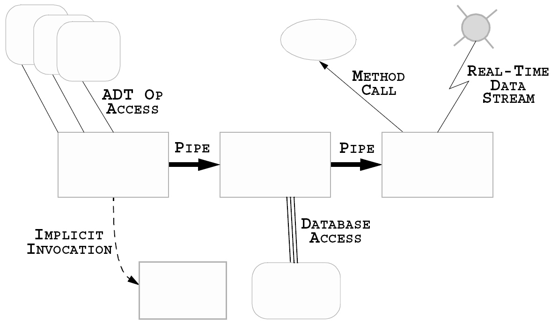
Where are Connectors in Software Systems?
Software Architecture: Foundations, Theory, and Practice; Richard N. Taylor, Nenad Medvidovic, and Eric M. Dashofy; © 2008 John Wiley & Sons, Inc. Reprinted with permission.

Slide 6
Implemented vs. Conceptual Connectors
Connectors in software system implementations
Frequently no dedicated code
Frequently no identity
Typically do not correspond to compilation units
Distributed implementation
Across multiple modules
Across interaction mechanisms

Slide 7
Implemented vs. Conceptual Connectors (cont’d)
Connectors in software architectures
First-class entities
Have identity
Describe all system interaction
Entitled to their own specifications & abstractions

Slide 8
Reasons for Treating Connectors Independently
Connector ≠ Component
Components provide application-specific functionality
Connectors provide application-independent interaction mechanisms
Interaction abstraction and/or parameterization
Specification of complex interactions
Binary vs. N-ary
Asymmetric vs. Symmetric
Interaction protocols

Slide 9
Treating Connectors Independently (cont’d)
Localization of interaction definition
Extra-component system (interaction) information
Component independence
Component interaction flexibility

Slide 10
Benefits of First-Class Connectors
Separate computation from interaction
Minimize component interdependencies
Support software evolution
At component-, connector-, & system-level
Potential for supporting dynamism
Facilitate heterogeneity
Become points of distribution
Aid system analysis & testing

Slide 11
An Example of Explicit Connectors
Components A and B communicate via a Unix pipe
Pipes overall behavior
Some statement by the designer
What is still missing is some properties of the connection.
Software Architecture: Foundations, Theory, and Practice; Richard N. Taylor, Nenad Medvidovic, and Eric M. Dashofy; © 2008 John Wiley & Sons, Inc. Reprinted with permission.

Slide 12
An Example of Explicit Connectors
This Pipe Properties
Unformatted streams of data
Single interaction channel
Unidirectional data transfer
Does not buffer the data
Attempts to deliver the data at most once
Software Architecture: Foundations, Theory, and Practice; Richard N. Taylor, Nenad Medvidovic, and Eric M. Dashofy; © 2008 John Wiley & Sons, Inc. Reprinted with permission.

Slide 13
An Example of Explicit Connectors (cont’d)
Say we wanted to:
change the nature of the data from an unformatted byte stream to discrete, typed packets.
In this case we want to use an event bus connector
?
Say we wanted to:
to ensure the delivery of data: If the recipient is not available.
Is this possible with pipes?
Software Architecture: Foundations, Theory, and Practice; Richard N. Taylor, Nenad Medvidovic, and Eric M. Dashofy; © 2008 John Wiley & Sons, Inc. Reprinted with permission.

Slide 14
Software Connector Roles
Locus of interaction among set of components
Protocol specification (sometimes implicit) that defines its properties
Types of interfaces it is able to mediate
Assurances about interaction properties
Rules about interaction ordering
Interaction commitments (e.g., performance)
Roles that Connectors can take on
Communication
Coordination
Conversion
Facilitation

Slide 15
Connectors as Communicators
Main role associated with connectors
Supports
Different communication mechanisms
e.g. procedure call, RPC, shared data access, message passing
Constraints on communication structure/direction
e.g. pipes
Constraints on quality of service
e.g. persistence
Separates communication from computation
May influence non-functional system characteristics
e.g. performance, scalability, security

Slide 16
Connectors as Coordinators
Determine computation control
Control delivery of data
Separates control from computation
Orthogonal to communication, conversion, and facilitation
Elements of control are in communication, conversion and facilitation

Slide 17
Connectors as Converters
Enable interaction of independently developed, mismatched components
Mismatches based on interaction
Type
Number
Frequency
Order
Examples of converters
Adaptors
Wrappers

Slide 18
Connectors as Facilitators
Enable interaction of components intended to interoperate
Mediate and streamline interaction
Govern access to shared information
Ensure proper performance profiles
e.g., load balancing
Provide synchronization mechanisms
Critical sections
Monitors

Slide 19
Connector Types
Procedure call
Data access
Event
Stream
Linkage
Distributor
Arbitrator
Adaptor

Slide 20
A Framework for Classifying Connectors
Category: Communication, Coordination, Conversion, Facilitation
Types are overall arching style of interaction.
Dimension are parameters of the connection
Species are particular instantiations or examples of connections.
Software Architecture: Foundations, Theory, and Practice; Richard N. Taylor, Nenad Medvidovic, and Eric M. Dashofy; © 2008 John Wiley & Sons, Inc. Reprinted with permission.

Slide 21
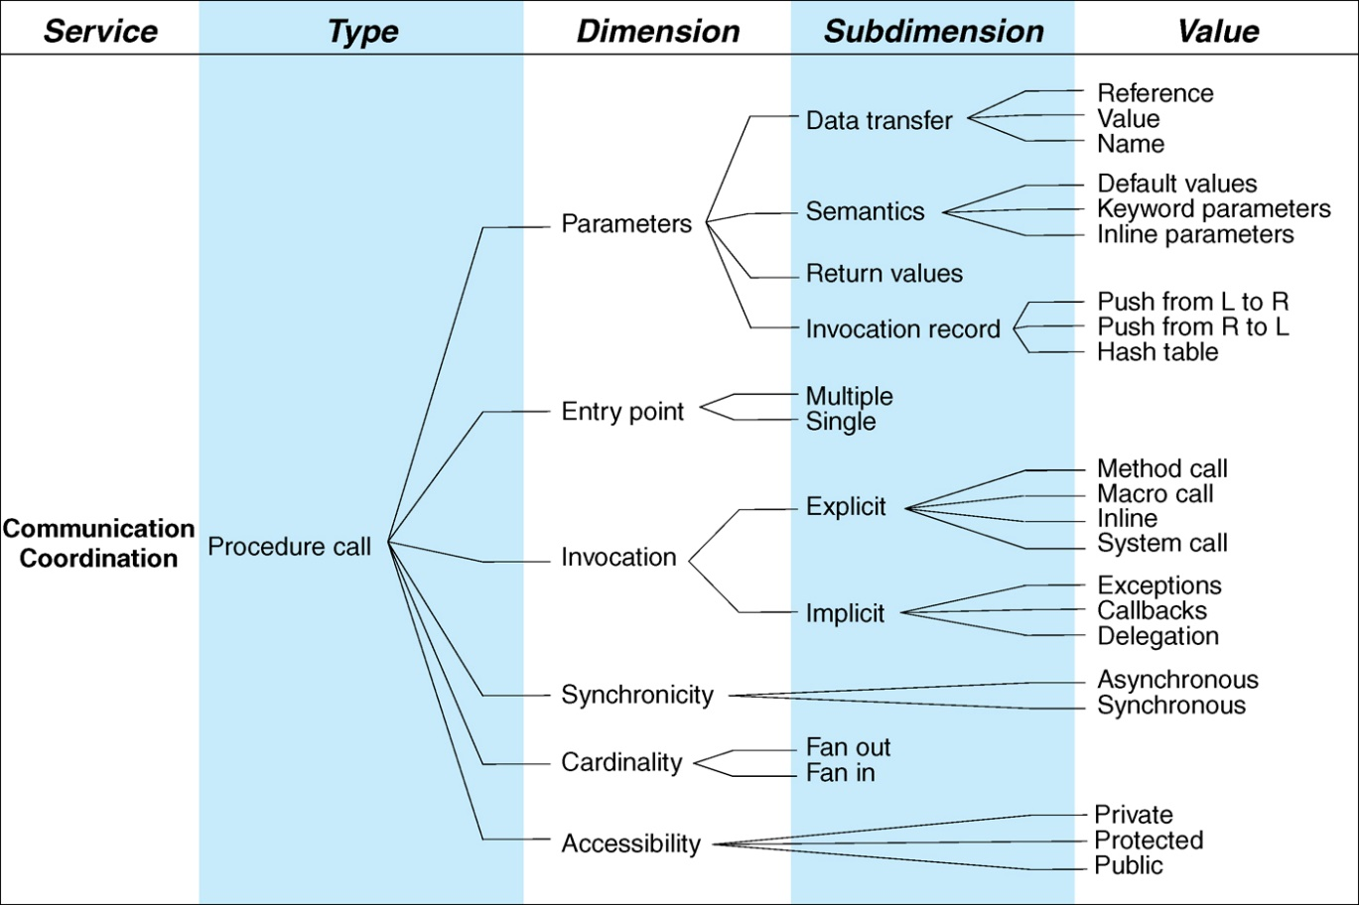
Procedure Call Connectors
Procedure Call Connectors model:
Coordination Service: Control among components (invocation techniques)
control is with the calling routine and then control shifts to be with the called routine.
Communications Service: Transfer of data (via parameters)
Facilitation Service: Facilitate remote procedure call as a “composite” connector
It is a core connector for the RPC
An example is the Java Method Call:
Passes by Value
Return value
Method call
Fan out/in is 1:1
Synchronous calls

Slide 22
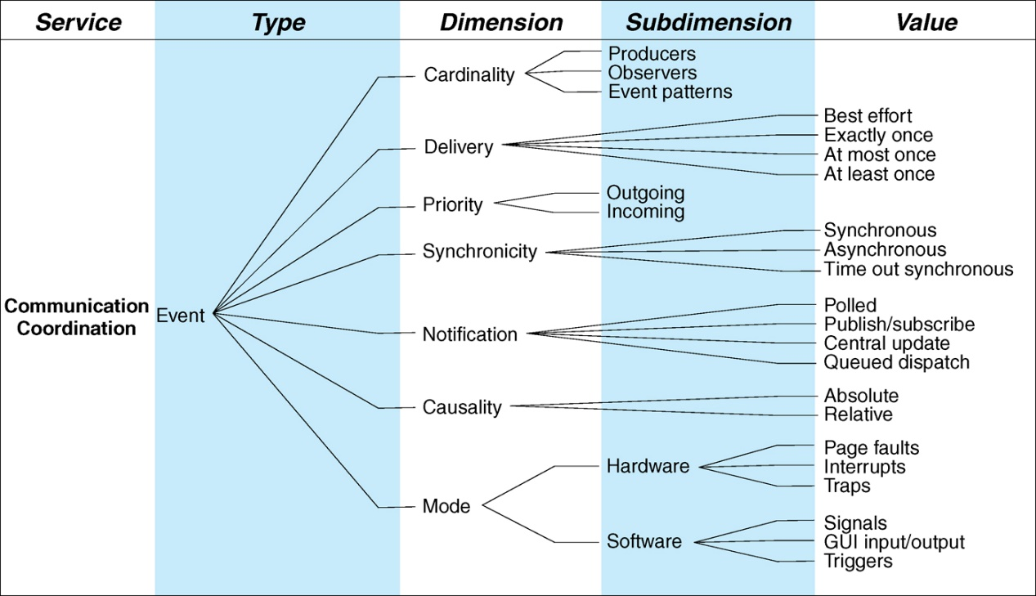
Event Connectors
Event Connectors model:
Coordination services: Regulate the flow of control among components (an event precipitates the flow of control to a component)
Communication services: transfers data about the event to those components who are interested

Slide 23
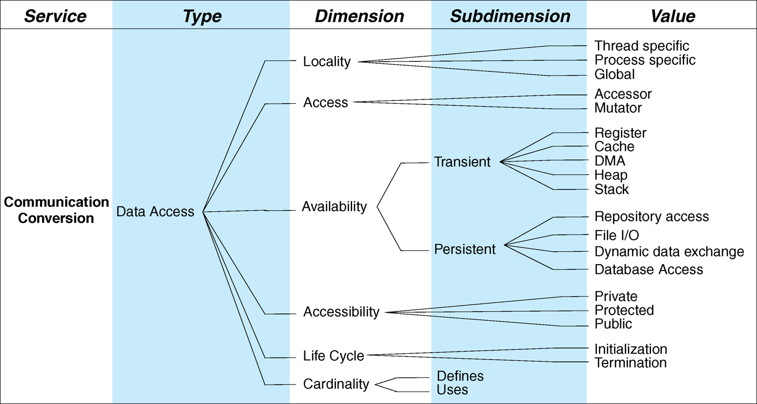
Data Access Connectors
Data Access Connectors model:
Communication services: connections to data stores, including preparation for connection and clean up after access.
Conversion services: performs any conversion of data formats and facilitates any access and query mechanisms.
Can provide translation
Can be persistent or transient
Who uses or defines the connector?

Slide 24
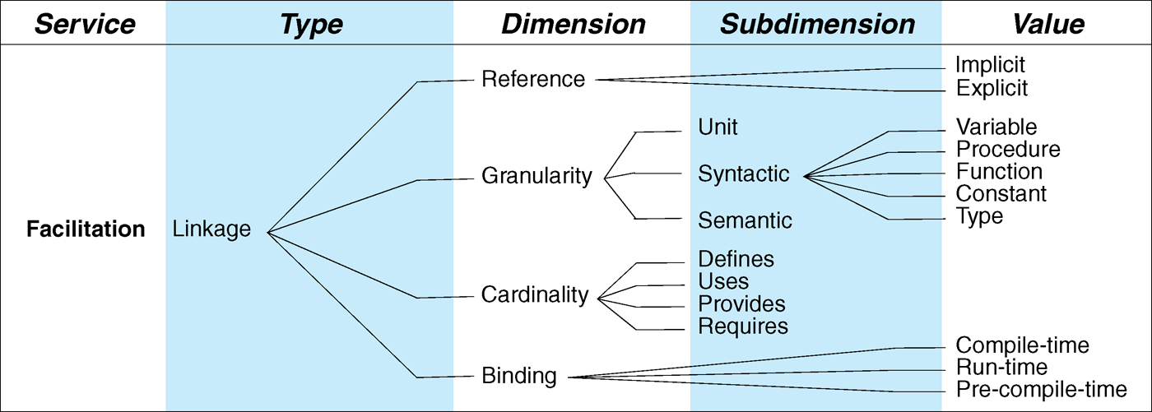
Linkage Connectors
Linkage connectors model:
Facilitation services: provides the “duct or channel ” to facilitate communications and coordination of information and enforces the interaction semantics
They describe the structure of the system
Think about link editors such as make files.

Slide 25
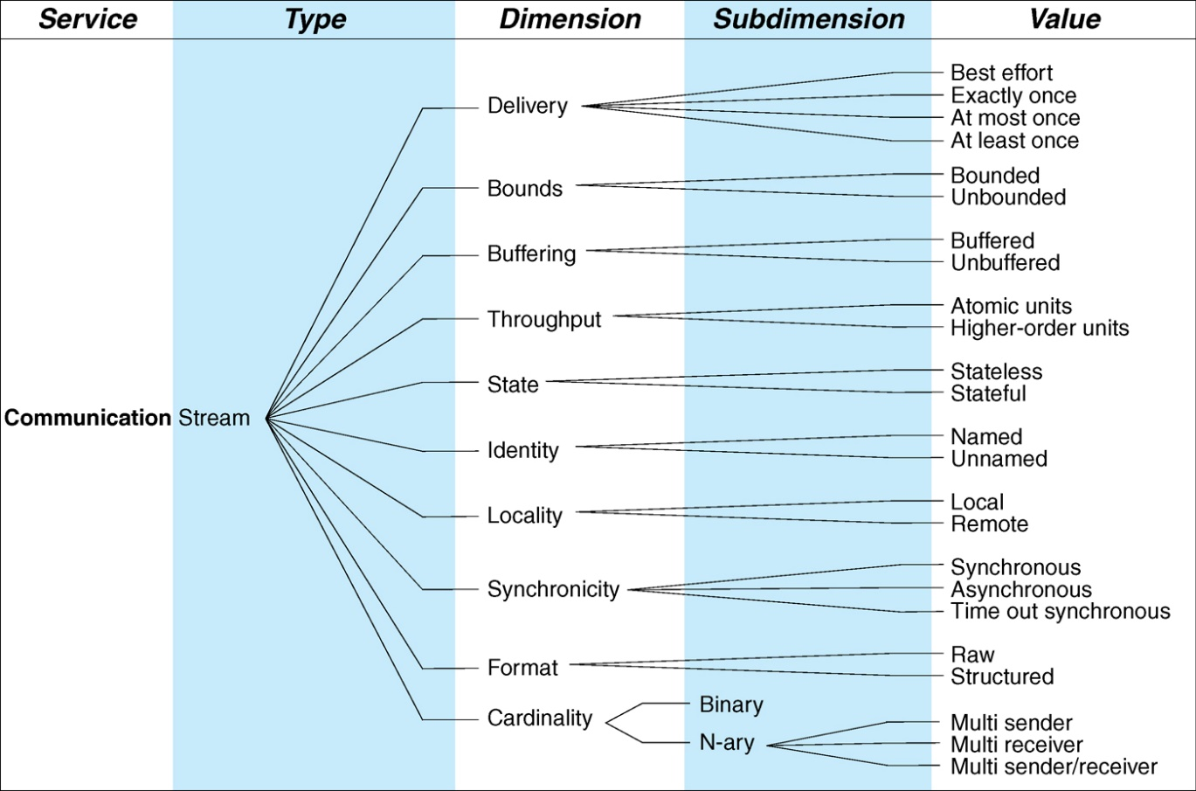
Stream Connectors
Stream connectors model:
Communication services: provide the transfer of large amounts of information (data) ; this service combined with data connector can form a composite connector of database and file storage access.
For Example Pipes
Can it buffer information, i.e. it is unbounded.

Slide 26
Arbitrator Connector
Arbitrator connectors model:
Facilitation services: resolves any conflict among components and thus assist and mediate the services among components
Coordination services: directing and redirecting the control flow among components
Can be used for negotiation
Examples
Load balancing
Fault handling
Concurrent processes
Transactional processes

Slide 27
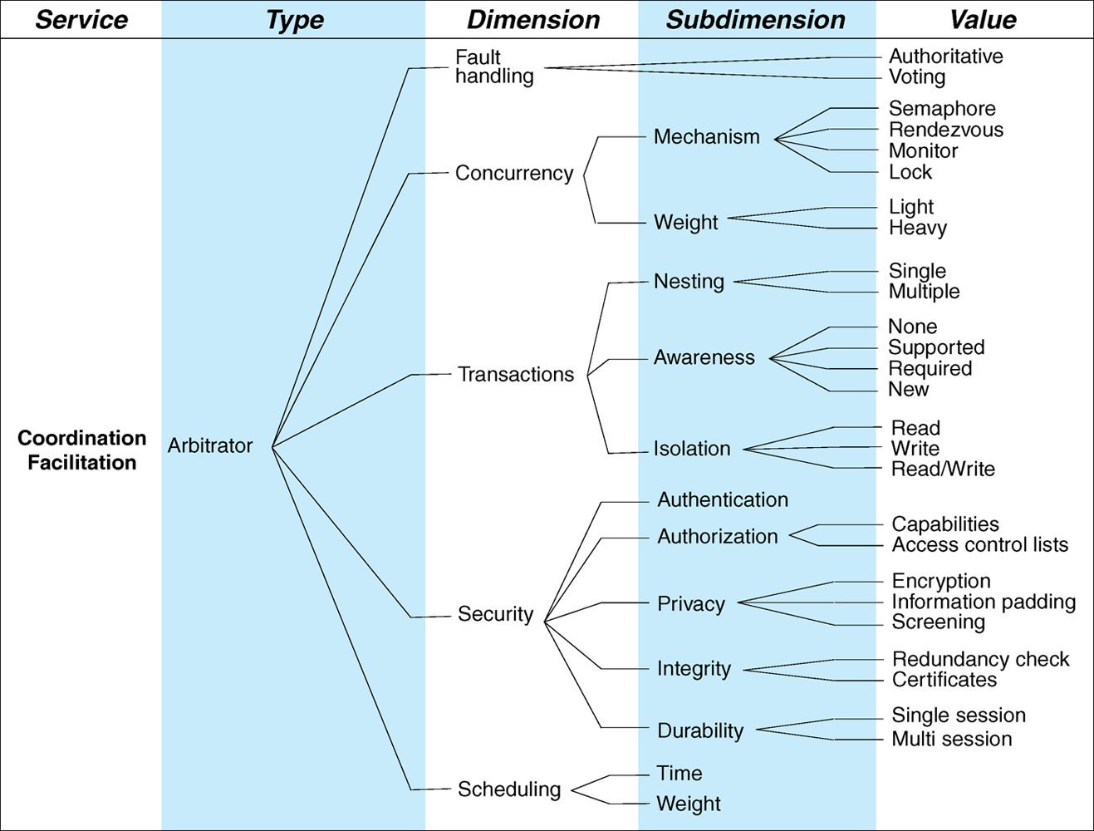
Arbitrator Connector

Slide 28
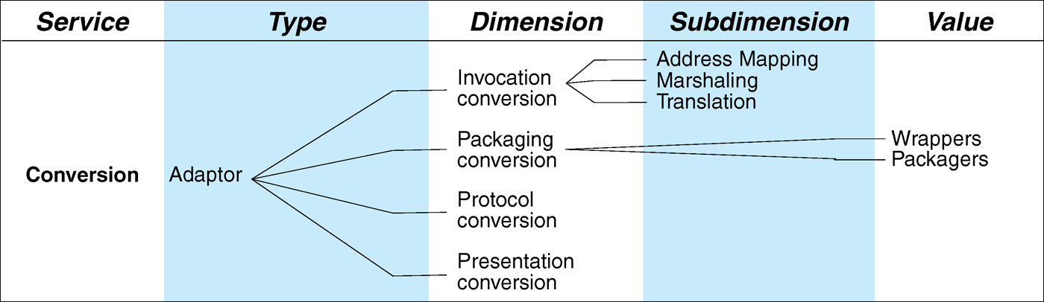
Adaptor Connector
Adaptor connectors model:
Conversion services: provide facilities to support interactions among components which were not initially designed to interoperate (e.g. different operating environment, different languages, different protocols, different policies, etc.).
An example of computation engine that can do this is XSLT

Slide 29
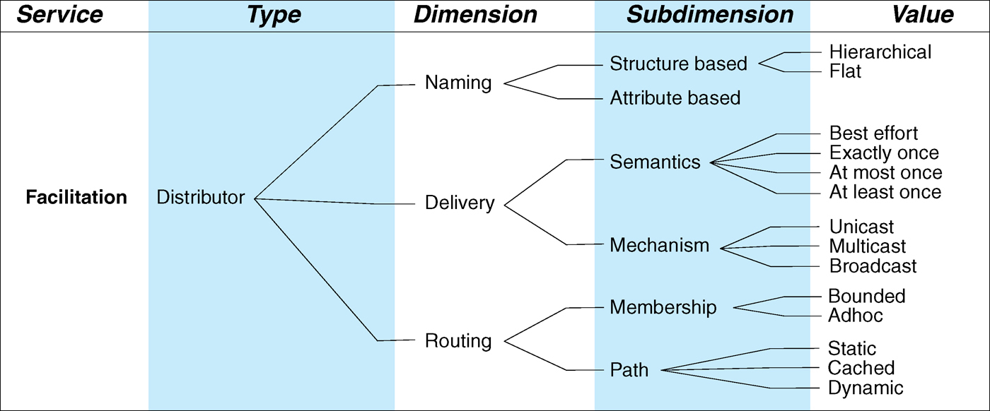
Distributor Connector
Distributor connectors model:
Facilitation services: identifies interaction paths and routing of communications and coordination information among the components. (This service is provided in conjunction with other connectors; thus distributor connector is usually composed with other connectors .)
Primary example is Domain Name Services (DNS)

Slide 30
Summary of Connector Types
So there’s a variety of different kinds of connector types, and these, these different types provide different categories of services.
Many of them are familiar, but some of them may be a little bit, new to you.
The point as with, earlier lessons is to be aware of what’s out there in case you need it in designing your systems.

Slide 31
Small Exercise
For the different mechanisms on the left what is a suitable connector type that describes that mechanism:
Procedure Calls
Event
Data Access
Linkage
Stream
Arbitrator
Adaptor
Distributor
RPC
Schedulers
Buffers
SQL

Slide 32
Composite Connectors: Distribution Connectors
Distribution connectors are composite connectors that is made up of the earlier mentioned connector types. They involve the following functionalities:
Data access
Stream based data access and packaging of data
Distribution of data to end users
4 widely used distribution connectors today:
Event-based
Grid-based
Client server based
Peer-to-peer based

Slide 33
Composite Data Distribution Connector
Distribution Connectors involve different combinations of 6 connector types: procedure call, event, arbitrator, data- access, stream & distributor
Procedure
call
Event
Arbitrator
evokes
evokes
evokes
“Invocation”
of some entity
performs
packages
data info
to be distributed
by
Data
access
Stream
Distributor
Use “common” set of connector types

Slide 34
Event-based Distribution Connector
Event-based utilizes 4 of the 6 connectors:
Event
Data access
Stream
Distributor
These connectors send and receive data via asynchronous notification called events
An example is a middle ware that performs publish-subscribe architectural style and involves some producer of information alerting subscribers ---events, which then kicks- off the accessing of various data. The accessed data is then packaged and streamlined for distribution by the distributor to the subscribers.

Slide 35
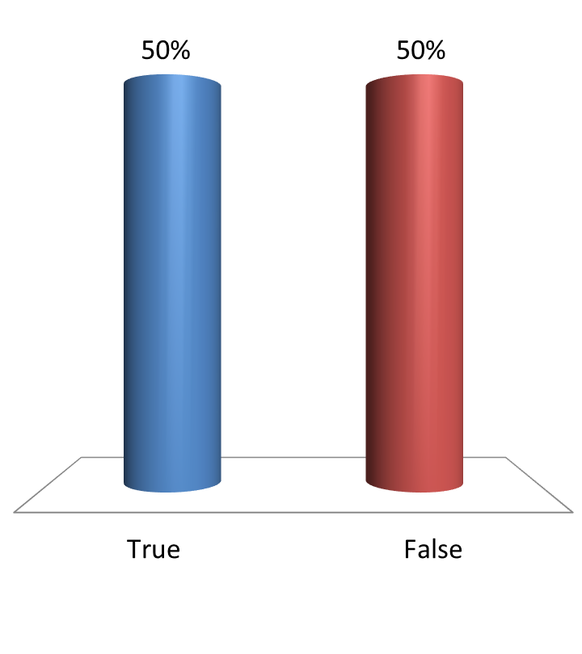
Event Streaming Connector is an Event-based Distribution Connector?
True
False

Slide 36
Grid-based Distribution Connector
Grid-based utilizes 4 of the 6 connectors:
Procedure call
Data access
Stream
Distributor
These connectors move and deliver large amounts of data among software components arranged in a network (grid) of shared computing and data resources.
This middle-ware is invoked via a named, synchronous procedure call. User authentication and security functionalities are provided, data-provider & functionality source and destinations are provided, parameters are passed by values with “keyword equals value”, actual data is packaged and streamlined, etc. in the grid-network with location & directory services to help distribution.

Slide 37
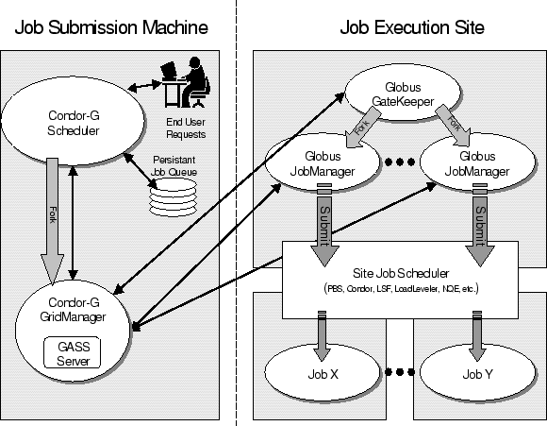
Typical GRID Architecture
This is GRID-based job scheduler

Slide 38
Client Server-based Distribution Connector
Client server-based utilizes the same 4 connectors as Grid :
Procedure call
Data access
Stream
Distributor
These connectors allow seamless distribution of data between client and server system using Remote Procedure Call (RPC).
This middle-ware is very much like the grid-based distribution connector, except the customer of service and the provider of service operates in a much more seamless manner (as if the service and data are “local”).

Slide 39
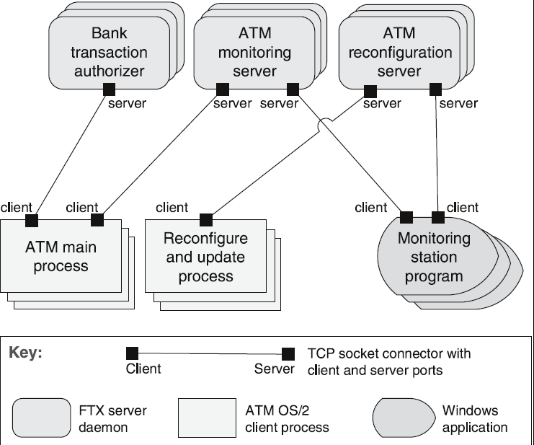
Client-Server Example

Slide 40
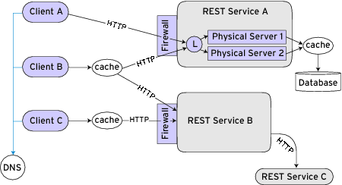
Client-Server REST Example

Slide 41
Peer-to-Peer-based Distribution Connector
P2P-based utilizes the 4 connectors :
Arbitrator
Data access
Stream
Distributor
These connectors differ from the previous 3 in that it is invoked via arbitration, which involves control flow redirection among distributed, peer resources. Arbitrators can negotiate various issues such as timing, scheduling, or protocols.
Once a peer is invoked via arbitration then the collection of data may also be through the peers in a distributed environment (also via arbitration). Data is then organized and package in chunks for transmission to other peers. Other peers are located via arbitration and the data is distributed to them.

Slide 42
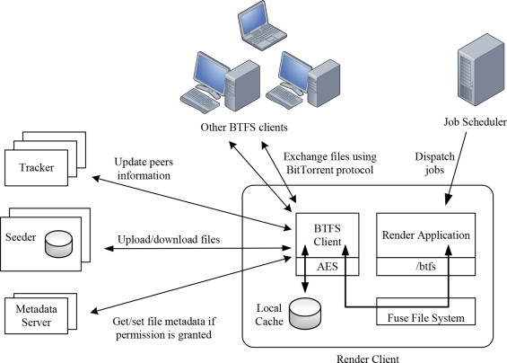
P2P BitTorrent Architecture
Tracker is used as arbitrator
BitTorrent protocol used for Data Access and streaming
Client decides who to get data from.

Slide 43
Comments on Distribution Connectors
In the current literature we do not see these referred to as connectors but simply as architectures.
In other words you will find several different architectural styles for:
Grid (now SOA is more common)
Peer to peer
Client/Server
The components in these architectures are connected via the fundamental connectors defined in the previous slides.

Slide 44
Class Exercise
A common distributed communication model is known as Message-Oriented-Middleware (MOM).
One can consider this as a form of connector between distributed objects.
Read through a description of MOM from Oracle https://docs.oracle.com/cd/E19316-01/820-6424/aeraq/index.html
What type of basic connectors does MOM leverage?

Slide 45
More Examples

Slide 46
The Linux File Facade
Commonly used abstraction to access devices and file systems in Linux.
It dispatches incoming system calls for file operations
Consider the complexity of interactions among the calling process and the requested file resource in the case where a “file open” call is made by a process on an exported NFS volume.
The file may be local or remote, and may be a link to yet another file. Further, the file may be in contention, requiring the connector to arbitrate the access. The calling process would also need to have rights to access this file.
In addition to coordination, the facade performs arbitration of interaction between the application process and physical file system and adaptation by dispatching calls to various file systems and device drivers.

Slide 47
The Linux File Façade Architecture
the facade allows simultaneous access to both readers and writers.

Slide 48
Shared Memory Access
commonly used IPC mechanism on Unix-like systems.
structurally composed of a supporting library of system calls that allow the creation, manipulation, and release of shared memory.

Slide 49
Shared Memory Access Architecture
Does not facilitate arbitration of data access among multiple readers and writers.

Slide 50
Process Scheduler
responsible for switching system resources between multiple user-level processes while ensuring that undesirable system states, such as deadlocks and resource starvation.
tries to optimize the utilization of system resources.
Links the operating system to the application processes, coordinates the processes’ access to system resources, and abstracts the resources in a manner that allows their easy access, independently of other processes.

Slide 51
Process Scheduler Architecture
realized as an extensible entity that may be used to configure a system’s characteristics.
For example we may redesign its scheduling property with a prioritized queue or a cooperative multitasking algorithm that will change the system’s performance accordingly

Slide 52
Comments on these Composite Connectors
Except for the Shared Memory the other connectors are created from the composition of several components communicating with different fundamental connectors.
I do not see these patterns referred to as “connectors” in the literature. They are mostly presented as an architecture.

Slide 53
Connector Selection Process
For complex, distributed systems, there is often a need to employ connectors. The following is a high level process for selecting connectors:
Identify the set of interacting components.
Determine the type of services these interacting components need.
Based on the 8 types of connectors, identify the connector types needed for each of those services.
Evaluate the chosen connector types for each service based on the interaction requirements. The evaluation should be based on the dimensions and sub-dimensions for each type of connector.
Identify the best connector or set of connectors for the interacting components; sometimes a composite connector needs to created .
For most of us this task is a tall order since connectors themselves are
relatively new.

Slide 54
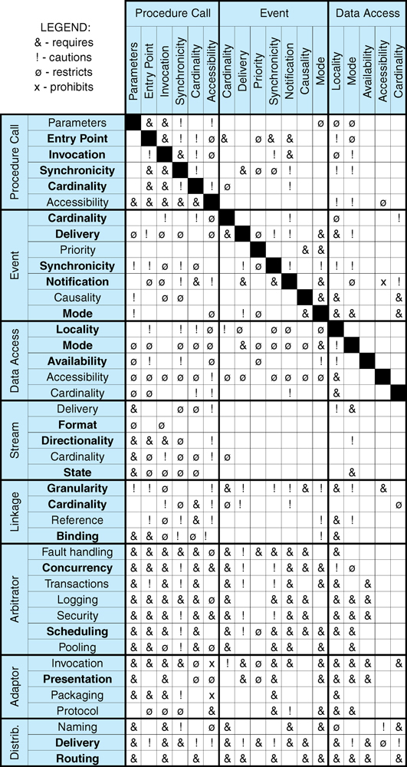
Connector Compatibility Matrix
This matrix helps to understand the constraints among the basic connector types

Slide 55
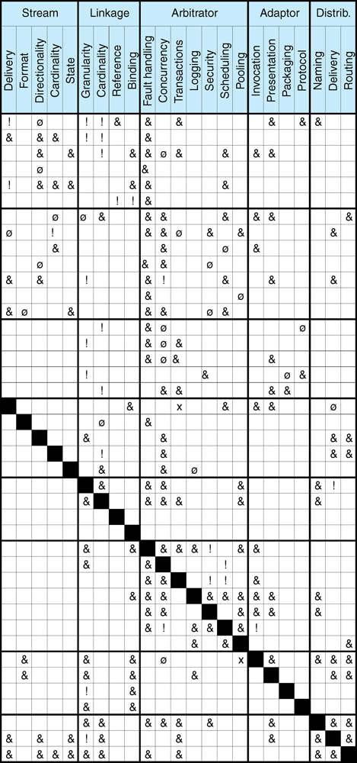
Connector Compatibility Matrix (contd.)

Slide 56
Discussion
Connectors allow modeling of arbitrarily complex interactions
Connector flexibility aids system evolution
Component addition, removal, replacement, reconnection, migration
Support for connector interchange is desired
Aids system evolution
May not affect system functionality

Slide 57
Discussion
Libraries of OTS connector implementations allow developers to focus on application-specific issues
Difficulties
Rigid connectors
Connector “dispersion” in implementations
Key issue
Performance vs. flexibility

